Slide 1
Amproutes
M&I-ENG 664: Engineering Leadership & Entrepreneurship
Instructor: Nehal Patel
Group 9
Fall 2024
Notes:
Charlie

Slide 2
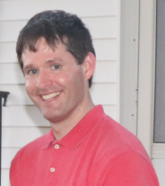




Project Team
Charles Galaska
CEO (Chief Executive Officer)
Narasimha Paleti CFO (Chief Financial Officer)
Siddharth Sharma
COO (Chief Operating Officer)
Jadyn Fletcher
CTO (Chief Technology Officer)
Harsh Panchal
CMO (Chief Marketing Officer)
Notes:
Charlie

Slide 3
Agenda
Project Overview Project Scope, Objective, Purpose
Work Breakdown Structure
Schedule Management
Risk Management
Cost Breakdown Structure
Concluding Remarks
Notes:
Charlie

Slide 4
Project Overview
Goals:
Supply stranded drivers of electric vehicles with a battery charge if they are low on battery, are stranded due to heavy traffic or there are no charging stations close.
Provide a fast charging battery to get the customer up and running as safe and fast as possible.
Capitalize on the market for the residential market to become the best car battery charging company.
Increase sales 10% one year after our initial opening in 2025 and expand from California to New York in 2026.
Increase sales 10% year over year and expand from New York to Massachusetts in 2027.
Purpose: Provide battery charging as roadside assistance in the Los Angeles area through Uber, Lyft, and Grub Hub networks.
Project name: Amproutes
Target Clients: Electric Vehicle Drivers
Product Idea: Quick emergency electric battery charge.
Project Begin date: 3/1/2024
Project End Date: 12/23/2024
Project duration: 297 days
Total Budget: $1,215,035.00
Key milestones:
Develop partnerships with rideshare and battery companies by 5/15/2024
Develop mobile applications by 7/13/2024
Pilot testing by 11/25/2024
Full-scale launch by 12/9/2024
Notes:
Siddarth

Slide 5

Project Scope
Amproutes is an innovative startup company providing portable electric vehicle batteries to customers whose electric vehicles are stranded and in need of a charge.
Amproutes will partner with Panasonic to procure a fast charging and portable battery that can be carried internally in a Lyft, Uber, or GrubHub driver’s car and transferred to a paying customer.
The battery is simplified so anyone mechanically inclined will be able to charge their vehicle if they are stranded and in need of a charge.
Amproutes will concentrate in the greater Los Angeles, California, in urban, suburban, and rural areas and expand in the future.
Notes:
Jadyn

Slide 6
Project Objectives, How Amproutes works
The customer will use Amproute’s mobile application or website to contact Amproute’s customer service representatives.
The customer will pay Amproutes for a delivery charge of $45.00 and a portable battery pack usage fee of $80.00.
When the customer pays Amproutes, Amproutes will connect with an Uber, Lyft, or Grubhub driver to pick up a battery pack from one of a few Amproute’s satellite locations and deliver a portable battery pack to the stranded driver.
The Stranded driver will charge the battery pack and recharge their vehicle in 10 minutes.
After a fast-charging battery pack fully charges the car, the customer will return the battery pack to the Uber, Lyft, or Grubhub driver.
The Uber, Lyft, or Grubhub driver will then return the battery pack to Amproute’s satellite locations for servicing and charging.
Amproutes will maintain and evaluate all batteries at their headquarters on an annual basis or if there are issues with the batteries. Satellite locations will be used for distribution and recharging the battery packs.
Notes:
Siddarth

Slide 7
Project Purpose
Amproutes services any electric vehicle.
Amproutes will recharge vehicles that are stranded if there is a power outage in a metropolitan area. Amproutes will have solar panels to generate power and save the power in batteries that can be used to charge the portable battery packs.
Amproutes is the only company that has portable battery chargers that can be delivered to average consumers.
Amproutes will recharge vehicles that run out of power if there are severe traffic delays due to accidents on major highways.
Amproutes can supply power to those in more rural locations if they are on vacation and drain their batteries if they are camping.
Amproutes will partner with all major electric car manufacturers who have the same battery adapter, including Tesla's own adapter.
Amproutes batteries will charge an electric vehicle in 10–30 minutes.
The battery packs are delivered quickly since they are delivered by Uber, Lyft, and Grubhub drivers who are constantly in route to their destinations.
Notes:
Jadyn

Slide 8
Vision and Mission
Vision: Recharge the world's electric vehicles by being the best and most efficient fast-charge electric vehicle battery company, rescuing those in distress on the side of the road whose car batteries ran out of charge.
Mission: Amproutes serves the public by helping rescue stranded drivers of electric vehicles by quickly charging their electric vehicles.
Notes:
Charlie

Slide 9
Business Model and Scalability
Primary office onsite at Amproutes Headquarters, 3250 Glendale Blvd., Los Angeles, California.
Satellite locations will be spread out within a few miles of each other in Los Angeles to create network locations so Uber, Lyft, and Grubhub drivers can pick up and drop off battery packs efficiently. It is going to be important to have this network so we can reach as many customers as possible.
The company will focus operations in urban and suburban areas where there are more potential customers with electric vehicles. Urban and suburban areas have more electric vehicles and a larger customer base with the greatest profits. Our company will service other areas outside of metropolitan areas but have to charge greater delivery fees.
New government regulations requiring electric vehicles in the coming years will require everyone to convert from gas to electric vehicles, which over the next 10 years will increase the pool of potential customers the business can acquire.
Future Area Expansion
We will achieve a profit of $1.5 million in Los Angeles, CA, within the first two years of operation from January 2025 to January 2027.
When we achieve a solid profit margin in Los Angeles, we are going to increase our company footprint to cover the lower Manhattan area, where there is a large density of potential customers. After achieving $2.2 million in sales in the Manhattan area, we can spread our business through the rest of New York City from January 2027 to January 2030.
We will increase our footprint through more suburban areas radiating from Los Angeles and New York City to gain ground from January 2030–January 2032.
We will expand to Boston, MA, using the same concept, gaining as much profit from the urban and suburban areas in January 2027–January 2035.
Notes:
Charlie

Slide 10
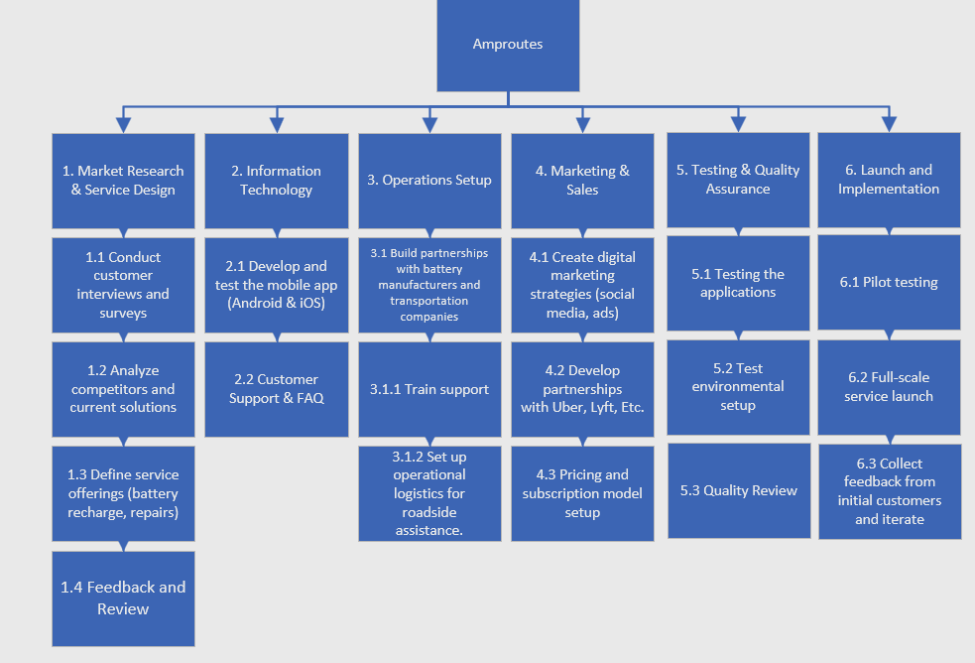
Work Breakdown Structure
Notes:
Jadyn

Slide 11
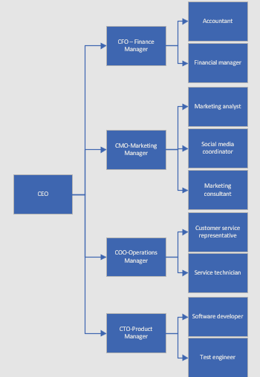
Organizational Breakdown Structure
Notes:
Jadyn

Slide 12
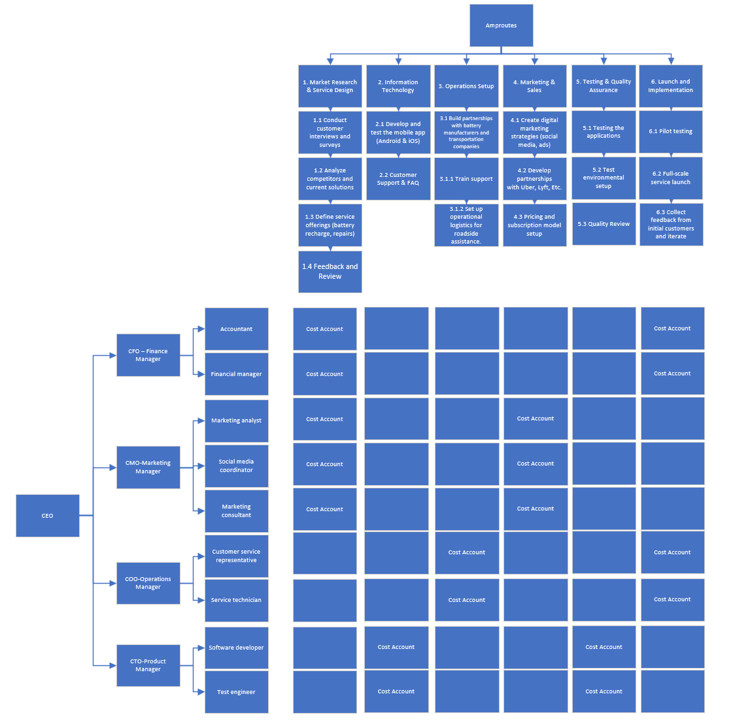
Responsibility Assignment Matrix
Notes:
Jadyn

Slide 13
Market Analysis
Electric vehicle market trends:
An estimated 8 percent of electric vehicle drivers run out of battery charge on their electric vehicles (1).The number of electric vehicles will significantly increase over the coming years. Electric cars are increasing in numbers; it is projected that 50% of passenger vehicles will be electric and upwards of 60%–70% by 2050 (4), raising the number of potential customers over the next 10 years. This increase is due to requirements making electric vehicles mandatory. Generally, in 2024, electric vehicle sales decreased for the first quarter of 2024 but the future will bring an increase in sales (5.)
Company Strategy:
Our company wants to focus on serving three major U.S. city areas: Los Angeles, Boston, and New York. After gaining the market in those areas, we want to spread out from the large cities and cover surrounding areas. Three states in particular are the best candidates for a strong battery recharging market, as shown below:
California: There are 1,256,646 electric vehicles in California.
Massachusetts: If you look at Massachusetts, there are at least 68,842 electric vehicles on the road (2).
New York: There are an estimated 62,000 electric vehicle drivers that are potential customers (3).
Competition: Sparkcharge is our only known competition at this time. Sparkcharge will not charge individual consumers vehicles but vehicles for fleets like car rental companies and large corporation’s delivery vehicles.
Demographics of customers: Currently, electric vehicles are largely owned by upper-class individuals but with the introduction of more mass-produced vehicles, government regulations requiring electric vehicles, and tax incentives in the past and in the future will allow middle- to lower-class income individuals to drive electric vehicles in the coming years.
1. How Many EV Owners Run Out Of Charge? The Number Might Surprise You
2. Boston is expanding electric vehicle charging network, bit by bit—masslive.com
3. Plug-in electric vehicles in New York (state) - Wikipedia
4. Ask a Scientist: It’s Getting Easier for US Car Owners to Go Electric—Union of Concerned Scientists
5. Why are EV sales slowing? | Goldman Sachs
Notes:
Harsh

Slide 14
How we will make Profits
Customers will use the Amproutes mobile application or website to request a battery pack, which will be delivered to a specific location by Uber, Lyft, and Grub Hub drivers. The company will make profits the following way:
A delivery charge of $45.00 for the battery pack. $33.00 will go to Amproutes, and $12.00 will go to the Lyft, Uber, or Grub Hub driver.
A battery pack usage fee of $80.00 will be charged to the customer.
The charging service will be kept relatively cheap so we can acquire a large bulk of customers. We do not want to prevent people with varying incomes from using the service.
Social media and advertising will ensure we can maximize profits by reaching out to masses of people.
Customers will be able to use our website and Android and iPhone applications as a way to order the service.
Notes:
Nara

Slide 15
Organization SMART Goals
SMART Goals
Goal: Cutting Costs while Improving Operations at the same time
Specific: Reduce operational costs by 10% without compromising our service quality. We will do this by negotiating deals with the vendors and revising our internal processes.
Measurable: By tracking our monthly financial reports and performing cost analysis. We can focus on sectors of logistics, marketing, and vendor contracts for battery purchases.
Achievable: Find better deals with the vendors/suppliers, compare them with our existing suppliers and also implement financial analysis to find things to improve on.
Realistic: Offering lowering prices of our services in the competitive market of electric batteries will attract a wider customer base.
Timely: We aim to achieve a 5% reduction by the end of the second quarter of 2025.
Notes:
Nara

Slide 16
Organization SMART Goals
SMART Goals
Goal: First Year Profitability
Specific: Secure a $250,000 profit in Los Angeles by the fourth quarter of fiscal year 2025.
Measurable: Profits are measured by tracking profits at the end of each quarter after accounting for taxes and operating expenses.
Achievable: Amproutes must have aggressive marketing strategies to reach customers. Battery packs must be safe, reliable, and fast-charging. Our mobile application to order the service must be able to reach everyone with Android and Apple cell phones and we need a reliable, easy-to-use website for ordering the service. We must have a good working relationship with Lyft, Uber, and Grub Hub.
Realistic: The goal is reasonable for a new startup company in Los Angeles that wants to aggressively expand. 2025 will be our initial year and we expect to have a lower profit margin after initial investments.
Timely: The company must push sales at the end of each quarter in order to achieve the fourth quarter goal of a $250,000 profit.
Notes:
Nara

Slide 17
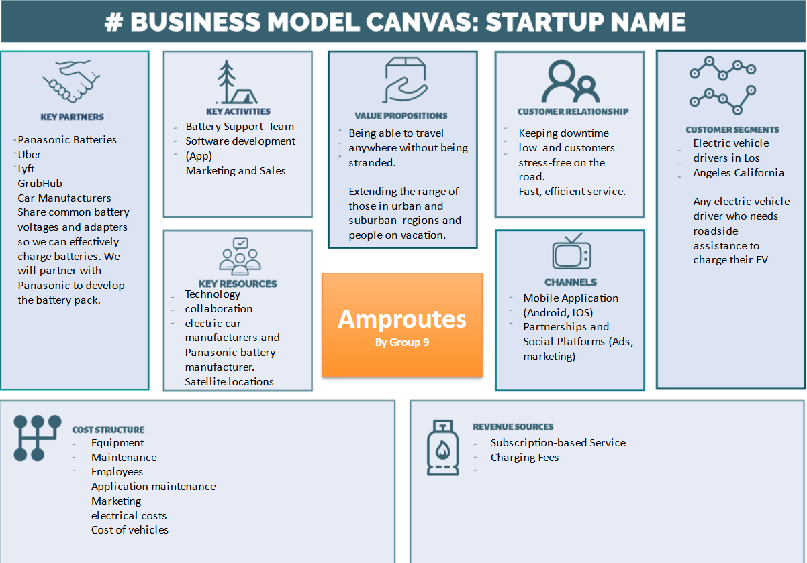
Business Model Canvas for Amproutes
Notes:
Charlie (Left) & Jadyn (Right)

Slide 18
Hiring Strategy
We will be hiring various staff per our organizational breakdown structure and other support staff. Following positions will be required:
Accountants: Keep track of our day-to-day operational finances.
Financial analyst: Analyzes our quarterly and fiscal year financial operations and determines how we can maximize our profits.
Marketing analyst: Determines if we are maximizing connections and communication with our clients. This position will require us to analyze our current marketing campaigns.
Social media coordinator: develop our website and promote our business.
Marketing consultant: an expert that makes recommendations on our marketing strategy and improves how we reach out and communicate with our customers using their experience from fortune 500 companies.
Software developer: Develop our phone application and website.
Test engineers troubleshoot batteries and work with portable battery supplier to develop our battery technologies.
Customer service representatives will handle customer requests and some will recharge batteries at the satellite location.
Service technicians will maintain the batteries.
Notes:
Siddarth

Slide 19
Hiring Strategy Continued
Skilled Labor: We will need to hire skilled financial, marketing, software development, and test engineers that are talented, strive to learn, and do the best they can to push Amproutes to the next level.
Unskilled labor: We can hire customer service representatives and service technicians that strive to make our company function as smoothly as possible.
Employee mentality and attitude:
Employees must be excited to work at Amproutes.
Its important for employees to want to learn and develop on the job.
We want energetic employees who are respectful to each other.
Employees need to be passionate about their roles and want to develop and move up in the company.
We encourage employees to want to take classes and be lifelong learners through our education assistance programs for associates, bachelor's degree and master’s degree assistance.
Employees need to treat customers with respect and keep an open mind to customer ideas, backgrounds, and cultures.
Employee Retention:
Matching 401K matches dollar for dollar until up to and including 3%.
Health care through Blue Cross Blue Shield.
Child care on site.
Tuition assistance $2,000 per semester for Associates, $3,000 per semester for Bachelors, and $2,500 per semester for Masters after 1.5 years of service. After the degree is complete, a mandatory 2.5 years of service to Amproutes needs to be completed.
Quarterly social events during the workday.
Bowling league and golf league.
Holiday Parties
15 paid vacation days
10 sick days
Notes:
Siddarth

Slide 20
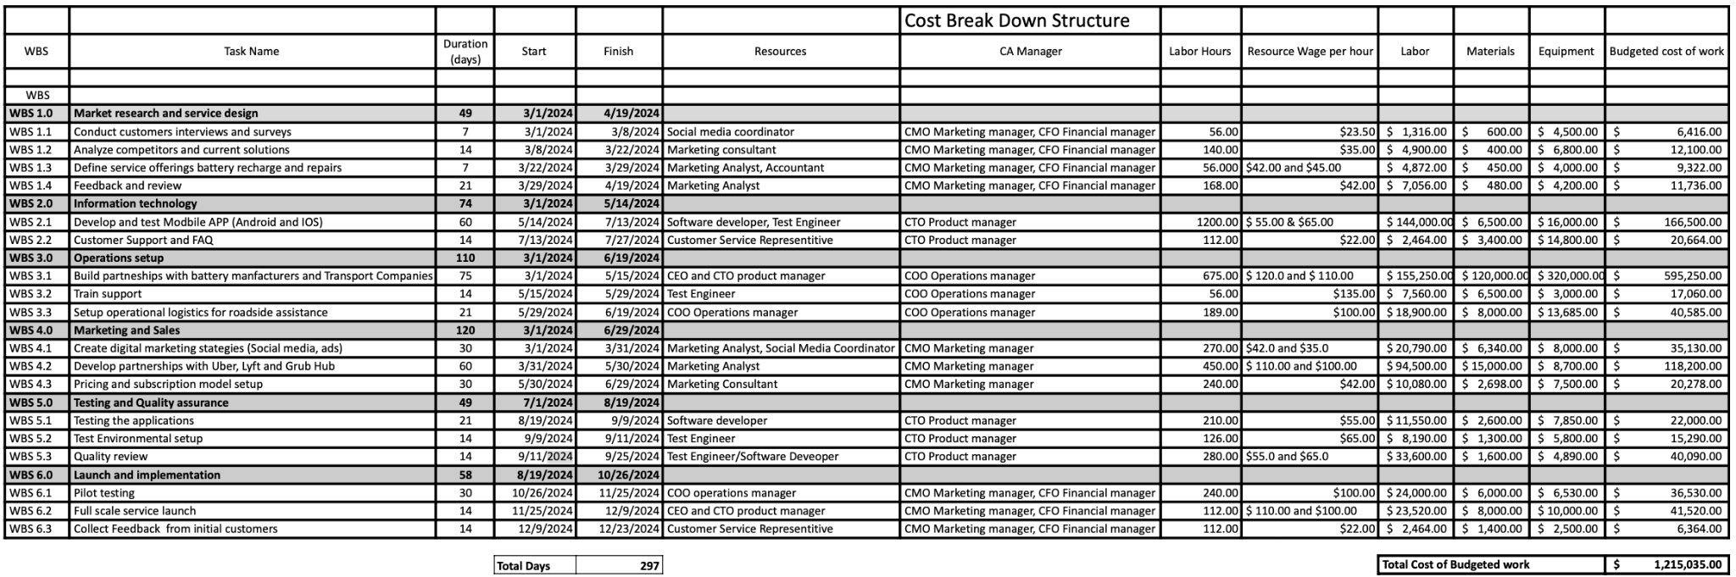
Budget and Financial viability: Cost Breakdown Structure
The total cost to start Amproutes will be $ 1,215,035.00
Notes:
Nara

Slide 21
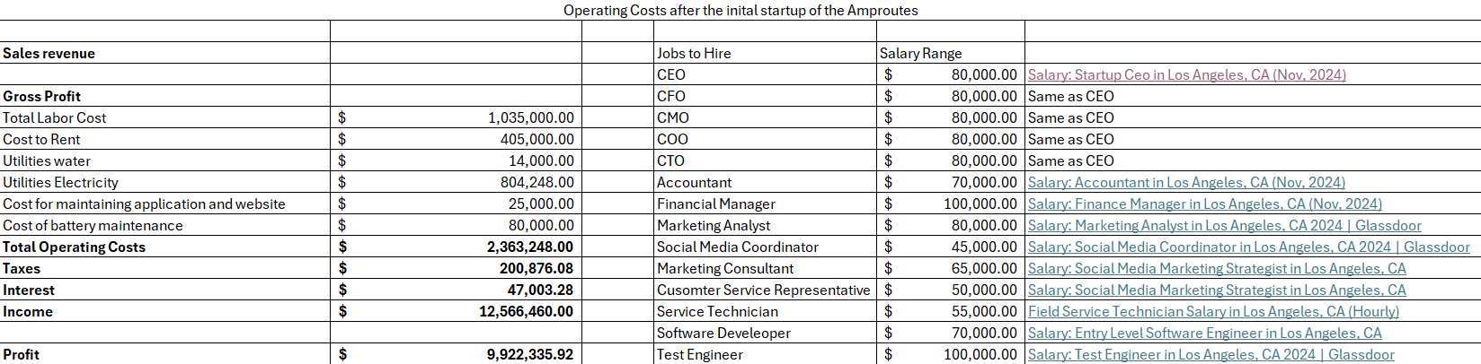
Continuous operating costs in California
Notes:
Nara Operating Costs.xlsx

Slide 22
Budget and Financial viability: Return on investment
The initial investment of Amproutes will be $1,215,035. From this, we will be able to start service of charging electric batteries.
Since there are over a million electric vehicles in California, the service should catch on with advertising and partnerships with Uber, Lyft, and Grub Hub.
The cost of one charge is $125 and the total profit expected is over 9 million USD from the number of electric vehicle owners that fully discharge the battery and are stranded.
The return on investment will be around 12 months as we expand to more satellite locations and more employees to cover the expanding business. The planned yearly operational costs are $2.6 million USD.
Notes:
Nara

Slide 23
Organizational and/or Business Risks and Issues
Consumers may decide to go back to fossil fuels to power their vehicles.
Government legislation forcing consumers to use electric vehicles may change more towards hybrid vehicles if voters are not satisfied with current technology or the cost of battery technology.
Another company could use the same business model in our areas of operation and attempt to take our charging market shares.
Battery obsolescence can occur. Manufacturers could decide to drastically change their battery designs, forcing us to develop our portable battery pack with Panasonic faster than we can respond.
Our battery supplier could decide to work with a future competitor so we will need a backup portable battery supplier.
There is a potential risk of a portable battery catching fire at any stage of our charging process. Batteries can sometimes be inherently chemically unstable in the right conditions.
Car manufacturers or another third party could develop a battery pack for consumers to leave in their car as a backup power source.
Notes:
Harsh

Slide 24
Start Up Funding Plan
A venture capitalist will be funding 60% of the start-up capital for Amproutes. The venture capitalist will control 30% of the company for 10 years until they receive their initial investment.
Bank of America will be funding 30% of the start-up capital for Amproutes at 5.25% interest for 15 years.
Amproute’s CEO will be paying for 10% of the startup capital.
Notes:
Nara

Slide 25
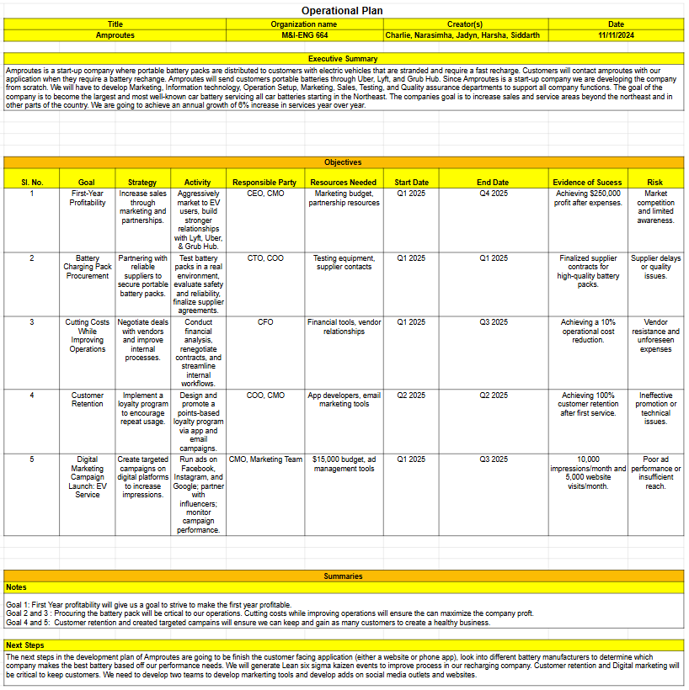
Operational
Plan
Notes:
Siddarth

Slide 26
Conclusion
Amproutes:
Roadside assistance company for electric vehicles that are stranded with little to no charge.
We will partner with rideshare companies like Uber, Lyft, and Grub Hub to leverage their driver networks to deliver a battery pack to our customers. This partnership will allow for short wait times, unlike services like AAA.
The service is easily accessible to the customer with our user-friendly interface of our website and mobile app.
Currently based in California, with the largest EV market with over a million EV’s on the road, but plan on expanding to the growing markets of New York, Massachusetts, and nationwide.
Future Plans:
By achieving a $1.5M profit in Los Angeles by 2027, we will expand to lower Manhattan, aiming for $2.2M in sales before scaling across NYC by 2030.
From there, we will target suburban areas around Los Angeles and NYC (2030–2032) and replicate this model in Boston, focusing on urban and suburban markets, with a goal of sustained growth through 2035.
Notes:
Siddarth

Slide 27
Questions?

Slide 28
Thank you!

